Slide 1
Talent Boost 2020 Final Task
Author: Milen Dimov

Slide 2
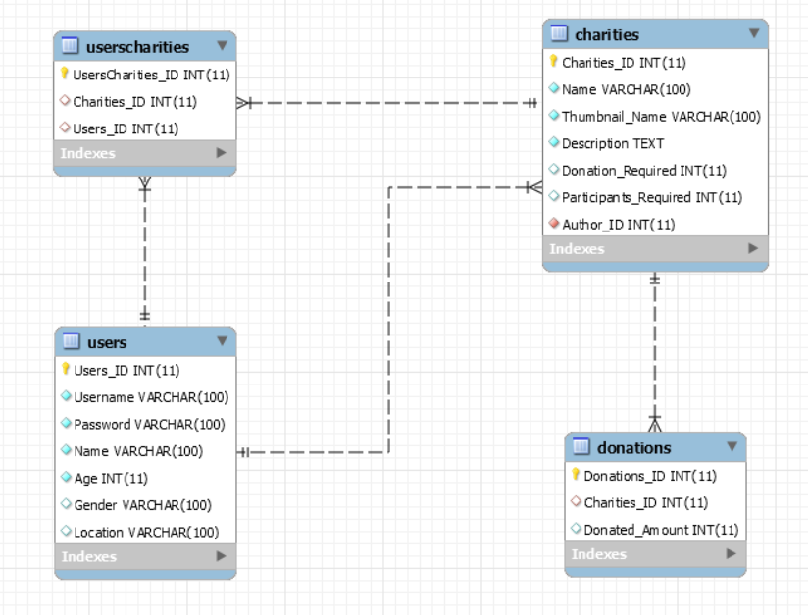
MYSQL DATABASE

Slide 3

Technologies
Frontend
Angular 9
HTML & CSS
TypeScript
Clarity design
Reactive forms
Backend
Spring boot
JDBC template
Integration tests

Slide 4

Thank you

